Slide 1

CSE 2213: Discrete Mathematics Section - O Room No - 325
Prof. Dr. A.K.M. Muzahidul Islam
Computer Science & Engineering (CSE)
United International University (UIU)
Email: muzahid@cse.uiu.ac.bd
Fall 2024

Slide 2
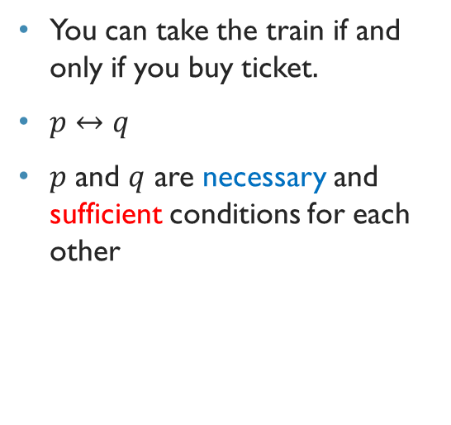
REVIEW :
BICONDITIONAL STATEMENT
Expresses that 2 propositions have the same truth value.
Definition 6: Let p and q be propositions.
The biconditional statement p ↔ q is the proposition “p if and only if q.”
The biconditional statement p ↔ q is
True when p and q have the same truth values, and
False, otherwise.
Biconditional statements are also called bi-implications.
p | q | p ↔ q
T | T | T
T | F | F
F | T | F
F | F | T

Slide 3
Examples
You can take the flight if and only if you buy a ticket
p: You take the flight
q: You buy a ticket
p ↔ q
Build the Truth Table
Below freezing is necessary and sufficient for it to be snowing.
p: It is below freezing
q: It is snowing
English Words for Biconditional:
p is necessary and sufficient for q
p iff q
if p then q and conversely
p →q
q →p
So, combinedly we can write p ↔ q

Slide 4
Determine whether these biconditionals are true or false
2+2=4 if and only if 1+1=2
2+2=4 is True
1+1=2 is True
T - T ↔ T
1+1 = 2 if and only if 2+3=4
T - F ↔ F
1+1 = 3 if and only if horse can fly
F - F ↔ T
0 > 1 if and only if 2 > 1
F - T ↔ F

Slide 5
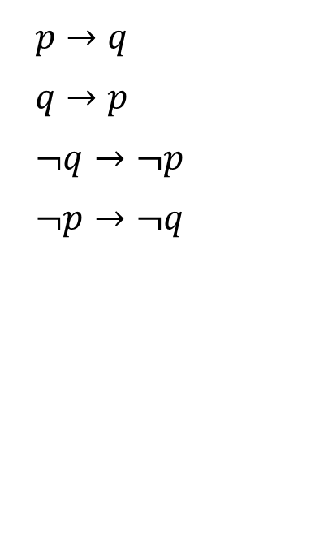
REVIEW :
CONVERSE, CONTRAPOSITIVE AND INVERSE
We can form some new conditional statements from a conditional statement p → q.
Converse
Contrapositive
Inverse
If it rains, I will stay home.
Converse : If I stay home, it is raining.
Contrapositive: If I do not stay home, it is not raining.
Inverse : If it does not rain, I will not stay home.
Which of these are equivalent? Prepare Truth Table

Slide 6
Exercise
p: I am in Dhaka
q: I am in Bangladesh
Conditional Statement:
p → q
if I am in Dhaka then I am in Bangladesh
Converse:
q → p
if I am in Bangladesh then I am in Dhaka
Inverse:
¬p → ¬q
if I am not in Dhaka then I am not in Bangladesh
Contrapositive:
¬q → ¬p
if I am not in Bangladesh then I am not in Dhaka
Build the Truth Table.
Show that the Conditional Statement and the Contrapositive have the Exact Match.

Slide 7
Exercise: English Sentence to Poposition
Let p and q be the Propositions
p: It is below Freezing
q: It is snowing
Write the propositions using p, q and logical connectives.
It is below freezing and snowing
p ∧ q
It is below freezing but not snowing
p ∨ ¬q
It is either snowing or freezing but not both
p ⊕ q

Slide 8
PREDICATES AND QUANTIFIERS

Slide 9
PREDICATES
Propositional logic, studied earlier, cannot adequately express the meaning of all statements in mathematics and in natural language.
Example 1 : “Every computer connected to the university network is
functioning properly.”
Example 2 : “There is a computer on the university network that is
under attack by an intruder.”
Example 3 : “Computer x is under attack by an intruder,”
Example 4 : “Computer x is functioning properly”
Example 5 : Statements with variables e.g., “x>3,” “x=y+3,” “x+y=z”

Slide 10
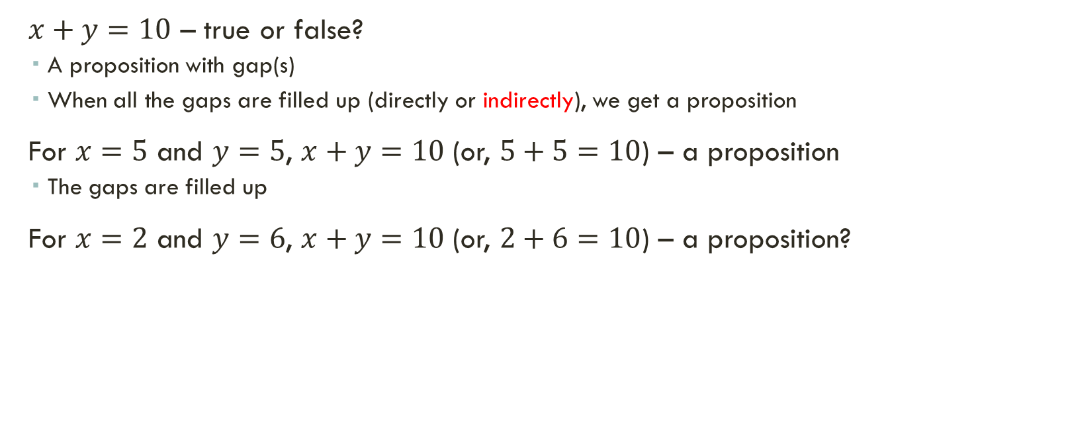
PREDICATES

Slide 11
PREDICATES
Example 5 : “x>3,”
The statement “x is greater than 3” has two parts.
The first part, the variable x, is the subject of the statement.
The second part—the predicate, “is greater than 3”.
We can denote the statement “x is greater than 3” by P(x),
P denotes the predicate “is greater than 3” and
x is the variable.
The statement P(x) is also said to be
the value of the propositional function P at x.
Once a value has been assigned to the variable x,
the statement P(x) becomes a proposition and has a truth value.

Slide 12
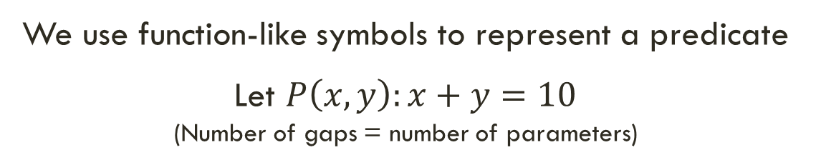
PREDICATES
Propositions | Representation by predicate | Truth value
“x > 3.” | P(x); Truth values of P(4) and P(2)? | ?
“Computer x is under attack by an intruder.” | A(x); Truth values of A(CS1), A(CS2), and A(MATH1)? | If, CS2 and MATH1 Under attack ?
“x = y + 3.” | Q(x, y); Q(1, 2) and Q(3, 0) | ?
“x+y=z” | ? | ?

Slide 13
PRECONDITIONS AND POSTCONDITIONS
The statements that describe valid input are known as preconditions
The conditions that the output should satisfy when the program has run are known as postconditions.
Example 6: Consider the following program:
temp := x
x := y
y := temp

Slide 14
The Program is designed to interchange the values of var x and y.
For the precondition,
it is needed that x and y have values before we run the program.
So, for this precondition we can use the predicate P(x, y),
where P(x, y) is the statement
“x = a and y = b,”
i.e., a and b are the values before we run the program.
Because we want to verify that the program swaps the values of x and y for all input values,
for the postcondition we can use Q(x, y),
where Q(x, y) is the statement
“x = b and y = a.”

Slide 15
Classification of Predicates
P(x) – Unary Predicates
“x is greater than 3”
For x=2, P(x) = 2 is greater than 3 : FALSE
For x=4, P(x) = 4 is greater than 3 : TRUE
Q(x, y) – Binary Predicates
“x is greater than y”
For (2,1), P(2,1) = 2 is greater than 1 : TRUE
For (3,4), P(3,4) = 3 is greater than 4 : FALSE
R(x, y, z) – Ternary Predicates
“x is greater than y and z”
“x can speak English”

Slide 16
Examples
Let P(x) denote the statement “x > 3”, what are the truth value of P(4) and P(2)?
P(x) is equal to x > 3
Thus, P(4) = 4 > 3 TRUE
Thus, P(2) = 2 > 3 FALSE
Let Q(x, y) denote the statement “x = y + 3”, what are the truth values of the propositions of Q(1, 2) and Q(3, 0)?
Q(x, y) is equal to x = y + 3
Thus, Q(1, 2), 1 = 2 + 3 FALSE
Thus, Q(3, 0), 3 = 3 + 0 TRUE
Let P(x) be the statement “the word x contains the letter E”, what are the truth value of P(UIU), P(Engineering) and P(CSE)?

Slide 17
QUANTIFIERS
A Quantification Creates a proposition from a propositional function.
A Quantification expresses the extent to which
a predicate is true over a range of elements.
The words all, some, many, none, and few are used.
Two types of quantification Assessment here:
Universal quantification (∀)
A predicate is true for every element under consideration, and
Existential quantification (∃)
There is one or more element under consideration for which the predicate is true.
Predicate calculus: The area of logic that deals with predicates and quantifiers

Slide 18
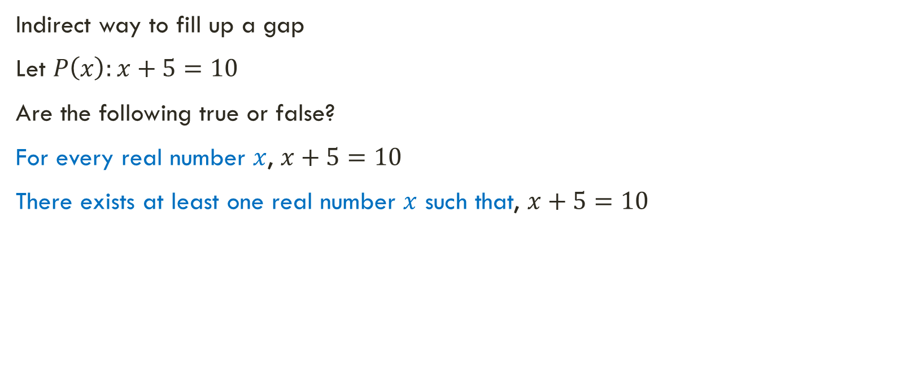

QUANTIFIERS
False
True
We Need to Specify the Domain

Slide 19
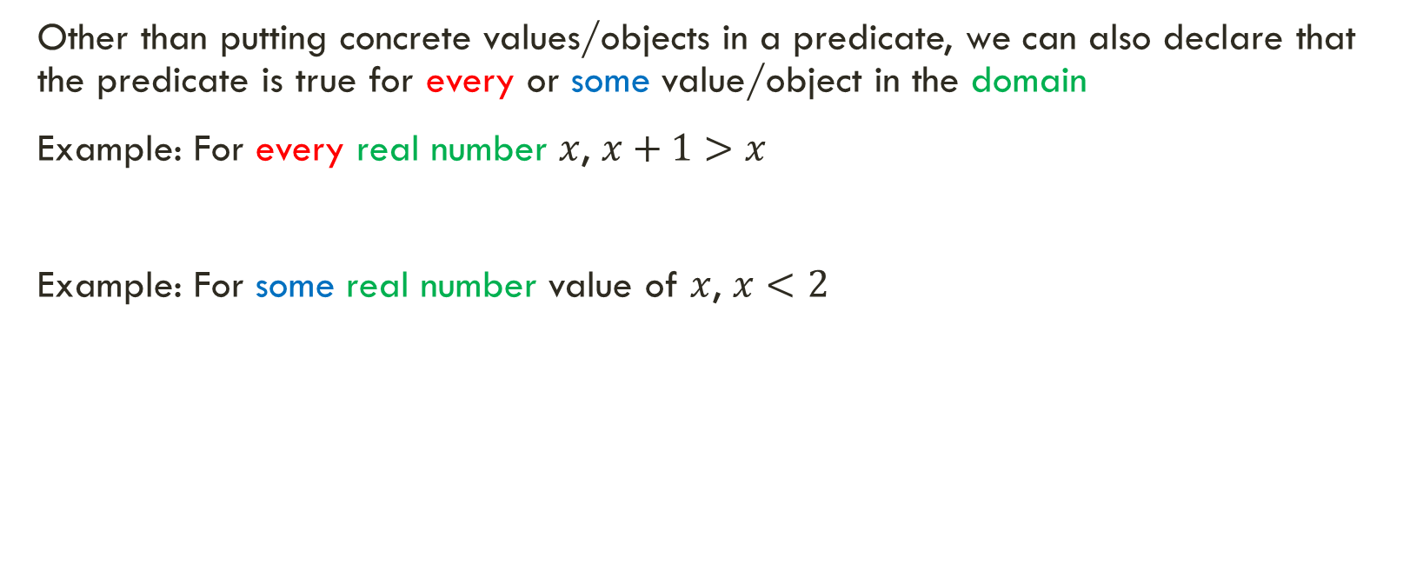




QUANTIFIERS
Universal quantifier
Existential quantifier

Slide 20
Definition 1
The universal quantification of P(x) is the statement
“P(x) for all values of x in the domain.”
The notation ∀xP(x) denotes the universal quantification of P(x).
Here ∀ is called the universal quantifier.
We read ∀xP(x) as “for all xP(x)” or “for every xP(x).”
An element for which P(x) is false is called a counterexample to ∀xP(x).

Slide 21
Definition 2
The existential quantification of P(x) is the proposition
“There exists an element x in the domain such that P(x).”
We use the notation ∃xP(x) for the existential quantification of P(x).
Here ∃ is called the existential quantifier.

Slide 22
Examples
Example 1: “x can speak English”
Domain Student
“P(x) = x can speak English.”
Note: Quantifier to assign value for the Predicates i.e., assign value of x.
Here ∀ is called the universal quantifier.
∀xP(x) i.e. “all students can speak English”
Here ∃ is called the existential quantifier.
∃xP(x) i.e. “there exists a student who can speak Japanese”

Slide 23
Examples
Example 2: “Let P(x) be the statement “x < 2”. What is the truth value of the quantification ∀xP(x), where the domain consists of all real numbers?
Domain is all real number
P(x) = x < 2.
P(1) = 1 < 2 TRUE
P(2) = 2 < 2 FALSE
P(3) = 3 < 2 FALSE
Example 3: “What is the truth value of ∀xP(x), where P(x) is the statement “x^2 < 10” and the domain consists of the positive integers not exceeding 4 i.e. x = {0, 1, 2, 3, 4}?
P(x) = x^2 < 10.
P(1) = 1 < 10 TRUE
P(2) = 4 < 10 TRUE
P(3) = 9 < 10 TRUE
P(4) = 16 < 10 FALSE

Slide 24
Examples
Example 4: “What is the truth value of ∃xP(x), where P(x) is the statement “x^2 > 10” and the domain consists of the positive integers not exceeding 4 i.e. x = {0, 1, 2, 3, 4}?
P(x) = x^2 > 10.
P(0) = 0 > 10 FALSE
P(1) = 1 > 10 FALSE
P(2) = 4 > 10 FALSE
P(3) = 9 > 10 FALSE
P(4) = 16 > 10 TRUE, thus ∃xP(x) is TRUE.

Slide 25


Slide 26
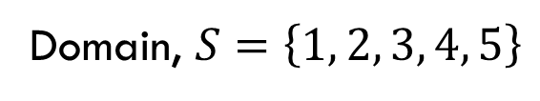
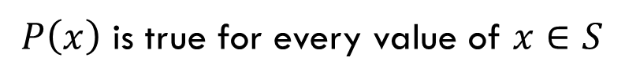
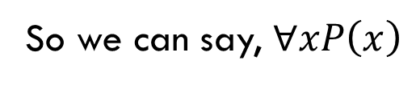
QUANTIFIERS AS CONJUNCTIONS AND DISJUNCTIONS
In general, universal quantifier is a shorthand for conjunctions of the predicate over all values of the domain
We can also say –

Slide 27
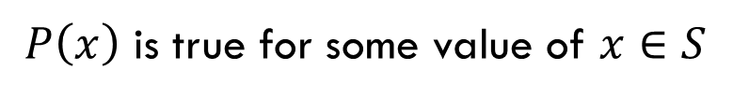
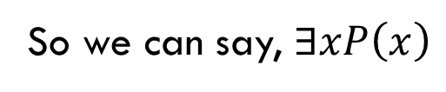
QUANTIFIERS AS CONJUNCTIONS AND DISJUNCTIONS
In general, universal quantifier is a shorthand for conjunctions of the predicate over all values of the domain
Similarly, existential quantifier is a shorthand for disjunctions of the predicate over all values of the domain
We can also say –

Slide 28
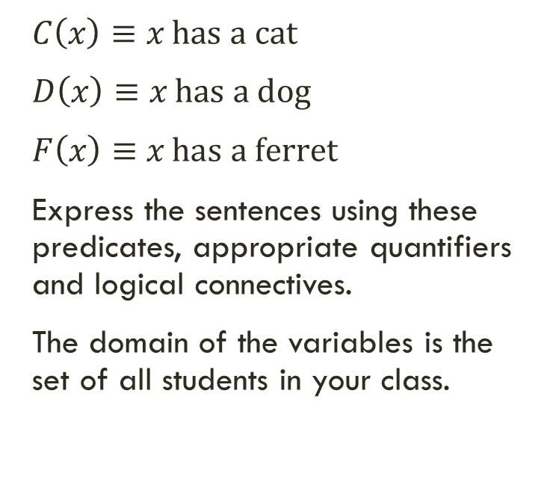
EXERCISE
A student in your class has a cat, a dog and a ferret
All students in your class has a cat, a dog or a ferret
No student in your class has a cat, a dog and a ferret

Slide 29
Howe work
Let P(x) be the predicate “x² – 1 = 0” where x is a real number. Determine the truth value of ∃x P(x).
Let Q(x,y) be the predicate “x < y” where x and y are integers. What does ∀x ∃y Q(x,y) mean in words?
Let R(x) be the predicate “x is even” where x is an integer. Write the statement “All integers are even” using predicate logic.
Let S(x) be the predicate “x is a mammal” and T(x) be “x can fly” where x is an animal. How would you express “Some mammals can fly” using predicate logic?
Let P(x,y) be the predicate “x is the parent of y” where x and y are people. Express “Everyone has a parent” using predicate logic.
Let Q(x) be the predicate “x is prime” where x is a positive integer. What is the negation of ∀x Q(x)?
Let R(x,y) be the predicate “x + y = 10” where x and y are integers. Is the statement ∀x ∀y R(x,y) true or false? Explain why.
Let S(x) be the predicate “x is a multiple of 5” where x is an integer. Express the statement “There is no integer that is a multiple of 5” using predicate logic.
Let T(x,y) be the predicate “x is taller than y” where x and y are people. Express the statement “Nobody is taller than themselves” using predicate logic.

Slide 31
NEGATION QUANTIFIERS
Limitation of propositional logic

Slide 32
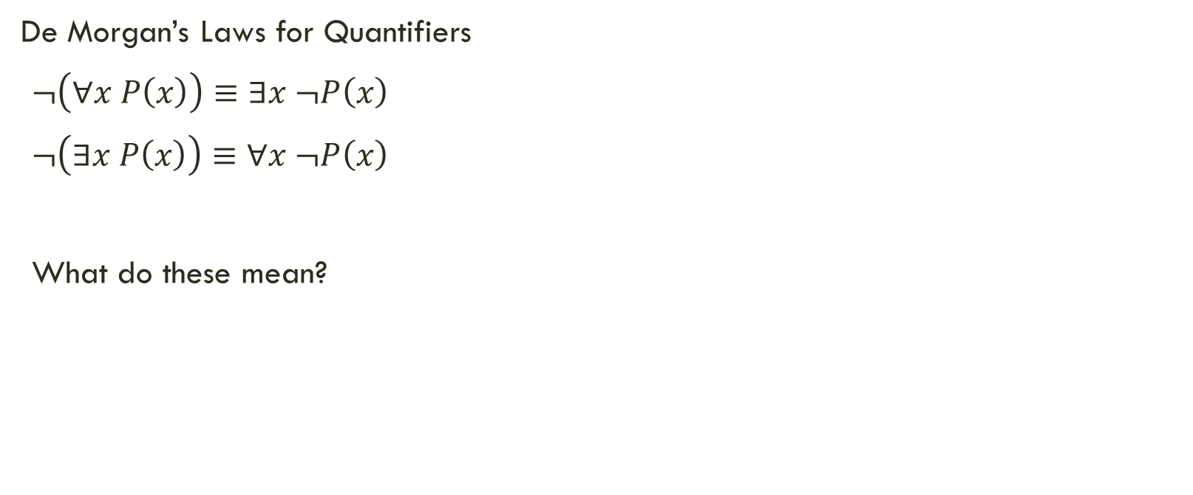
NEGATING QUANTIFIED EXPRESSIONS

Slide 33
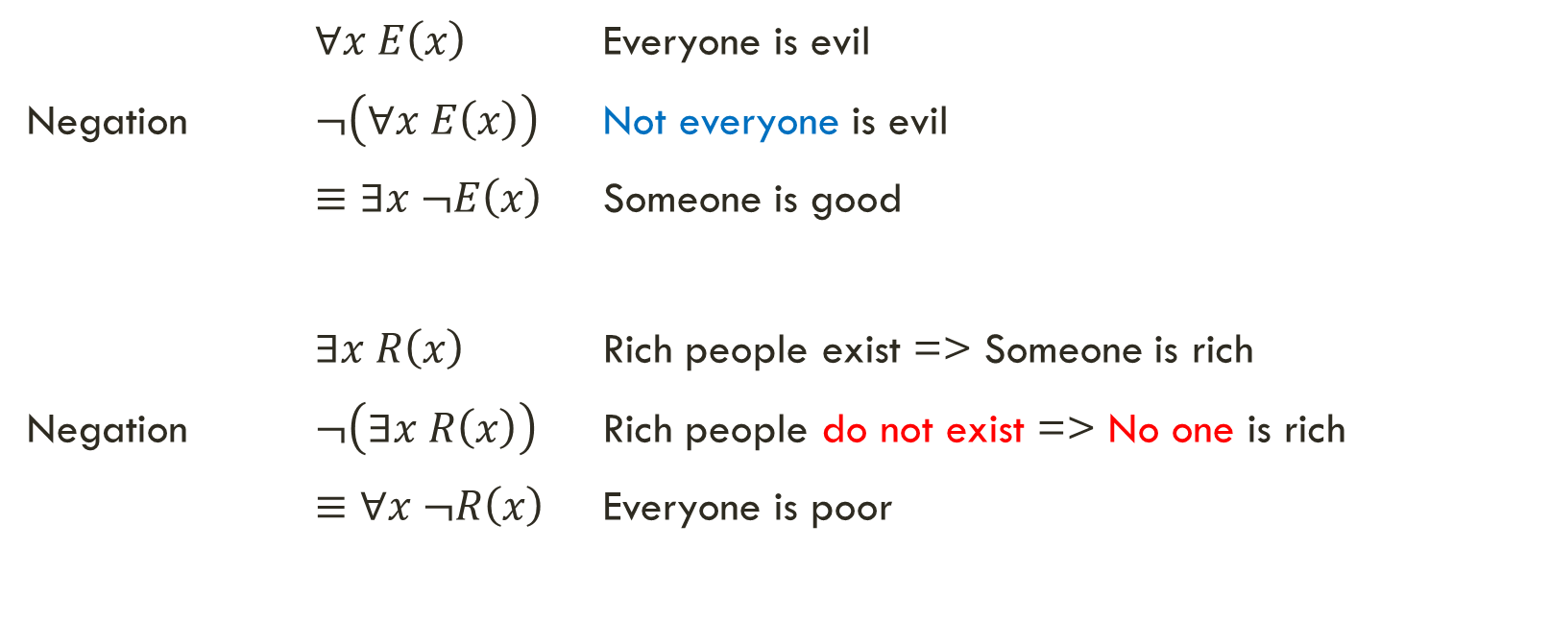
DE MORGAN’S LAW FOR QUANTIFIERS

Slide 34
Examples
Example 1: Every student in your class has taken a course in Calculus.
Answer : ∀xC(x)
Negation : ¬( ∀xC(x) ) = ∃x ¬C(x)
There is a student in your class who has not taken Calculus.
Example 2: There is an honest businessman.
Answer : ∃xH(x)
Negation : ¬(∃xH(x) ) = ∀x ¬H(x)
Every businessman is not honest.
Not all businessmen are honest.

Slide 35
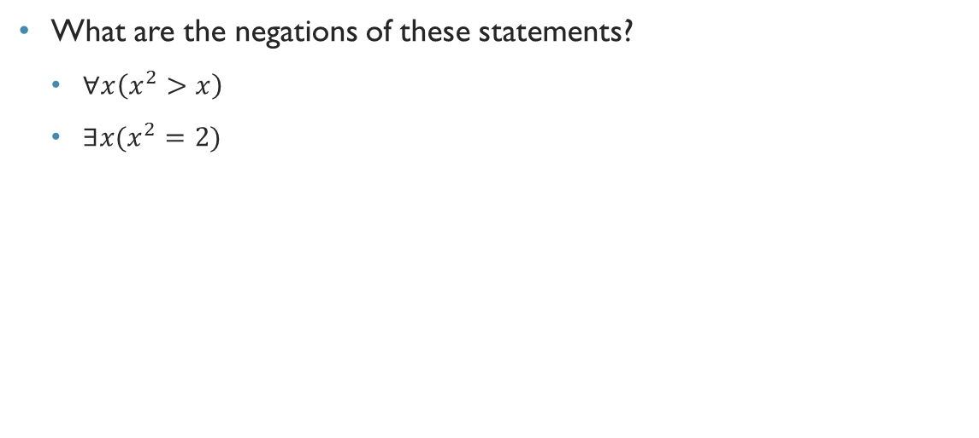
PROBLEM

Slide 37
NESTED QUANTIFIERS
Limitation of propositional logic

Slide 38
NESTED QUANTIFIER
One quantifier is within the scope of another quantifier.
Example 1: ∀x∃y(x + y = 0).
Everything within the scope of a quantifier can be thought of as a propositional function.
For example, ∀x∃y(x + y = 0) is the same thing as ∀xQ(x),
where Q(x) is ∃yP(x, y),
where P(x, y) is x + y = 0.
Example 2: Translate the following statement into English. Domain is Real Number.
∀x ∀y ((x > 0) ∧ (y < 0) → (xy < 0).
For every real number x and y,
if x is positive and y is negative, then xy is Negative

Slide 39
NESTED QUANTIFIER
Example 3: Translate the following statement into English. Domain is Real Number.
∀x ∀y ((x > 0) ∧ (y > 0) → (x + y > 0).
For every real number x and y,
if x is positive and y is positive, then the sum of x and y is Positive
Example 4: Translate the following statement into English. Domain is Real Number.
∀x (C(x) ∨ ∃y( C(y) ∧ F(x, y) ) ). Domain is ALL STUDENTS.
C(x) : x has a Computer
F(x, y): x and y are Friends.
For every student x in your school, x has a computer or there is a Student y s.t. y has a computer and x and y are friends.
Every student in your school has a computer or has a friend who has a computer.

